Slide 1
Crime & Community Exploratory
Data Visualization Course
Students:
Sathish Nandakumar
Rohan Kayan
Khaled Abou Samak
Term: Summer 2018

Slide 2
Motivation
Data analysis and visualization helps police departments to fight crime
Departments can detect correlations between statistics such as school truancy and a rise in neighborhood burglaries
Departments can detect correlations between statistics such as school truancy and a rise in neighborhood burglaries
The next generation of police work is tapping into complicated patterns and oft-underutilized data and applying data science in an effort to make high-crime neighborhoods safer
Visualization techniques helps the Law enforcement officers with better representation of statistical data and easy to understand what the data tells to plan for the action.
Exploratory data analysis and visualization gets into the roots of the problems in the community by finding patterns and reasonings in the data to build a safer and smarter communities
Notes:
Confirm scope and phases
Integration with portal to be accessed by customers

Slide 3
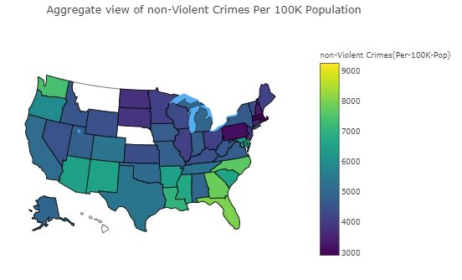
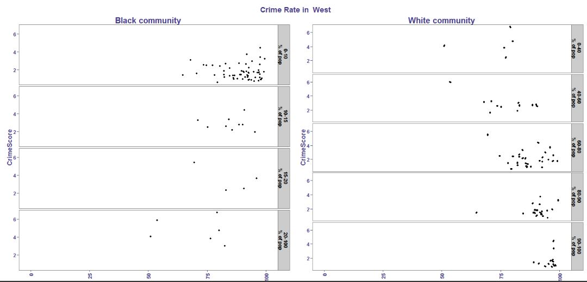
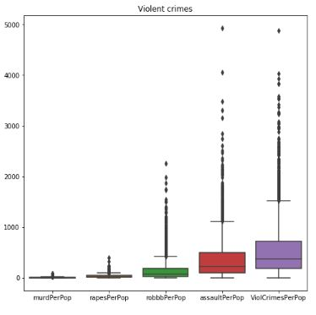
Related Works
There were some previous work related but very limited such as:
The previous related analysis was conducted on the state level and very few were done on the county/ community level
Some analysis were done focusing on few fields such as US regions and race
Some analysis were conducted for US state and city with some of the factors contributing to crimes
Example: State wise crime analysis and the top contributing features
https://www.kaggle.com/kkanda/analyzing-uci-crime-and-communities-dataset
Example: Region wise crime analysis only by race
https://rpubs.com/srimosri/46791
Notes:
Confirm scope and phases
Integration with portal to be accessed by customers

Slide 4
Dataset
Dataset name: Communities and Crime
Source: UCI machine learning repository. This is the real socio-economic data from 1990 US Census, law enforcement data from the 1990 US LEMAS survey, and crime data from the 1995 FBI UCR [13].
Number of Records: 2215
Number of Attributes: 147
http://archive.ics.uci.edu/ml/datasets/communities+and+crime+unnormalized
Notes:
Confirm scope and phases
Integration with portal to be accessed by customers

Slide 5
Dataset (continued)
The most important features which are used for exploratory data analysis. Latitude and longitude were added to the original dataset by matching the name of city
Field | Description | Date Type
Communityname | Name of the community in city | Text/string
State | US state | Nominal
countyCode | Numeric code for county | Nominal
communityCode | Numeric code for community | Numeric/ Decimal
ViolentCrimesPerPop | Total number of violent crimes per 100K population | Numeric/ Decimal
nonViolPerPop | Total number of non-violent crimes per 100K population | Numeric/ Decimal
TotalPctDiv | Percentage of population who are divorced | Numeric/ Decimal
FemalePctDiv | Percentage of females who are divorced | Numeric/ Decimal
MalePctDivorce | Percentage of males who are divorced | Numeric/ Decimal
PctKidsBornNeverMar | Percentage of kids born to never married | Numeric/ Decimal
PctPopUnderPov | Percentage of people under the poverty level | Numeric/ Decimal
Racepctblack | Percentage of population that is African American | Numeric/ Decimal
PctUnemployed | Percentage of people 16 and over, in the labor force, and unemployed | Numeric/ Decimal
PctNotHSGrad | Percentage of people 25 and over that are not high school graduates | Numeric/ Decimal
Community Latitude | GPS coordinates for communities | Numeric/ Decimal
Community Longitude | GPS coordinates for communities | Numeric/ Decimal
Notes:
Confirm scope and phases
Integration with portal to be accessed by customers

Slide 6
Key Findings and Insights
Results shows that there is significance correlation between no. of crimes and the impacting factors such as age, race, martial status, etc
Communities have high positive co-relation among Non violent crime and violent crime rate, i.e. the communities with high Violent crime have high non violent crime too.
For non-violent crimes, there are some cities like East Longmeadow, Atlantic, Myrtle Beach, Palatka and Miami Beach are reported with the highest no. of non-violent crimes.
Florida state has 8 out 20 highly reported cities with non-violent crimes
Communities have high positive co-relation among Non violent crime and violent crime rate.
Communities with high percentage of families with two parents with kids or teens have a strong negative impact on violent crime.
Communities with high percentage of Kids with never married parent have a high positive co-relation with violent crime.
For non-violent crimes, number of larcenies per 100K population is highest type of the non-violent crimes
For non-violent crimes, number of robberies and number of assaults per 100K are highest type of the non-violent crimes
Notes:
Confirm scope and phases
Integration with portal to be accessed by customers

Slide 7
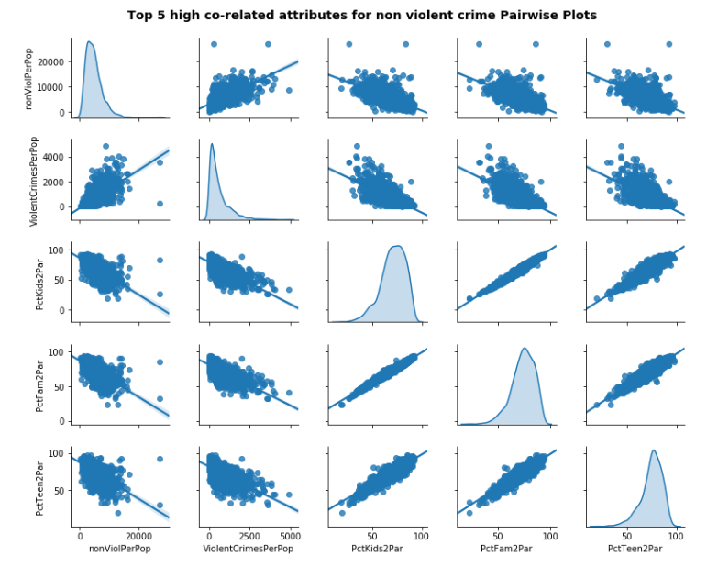
Factors correlated with the non-violent crimes
Communities have high positive co-relation among Non violent crime and violent crime rate, i.e. the communities with high Violent crime will have high non violent crime too.
Communities with high percentage of families with two parents with kids or teens have a strong negative impact on violent crime.
Notes:
Confirm scope and phases
Integration with portal to be accessed by customers

Slide 8
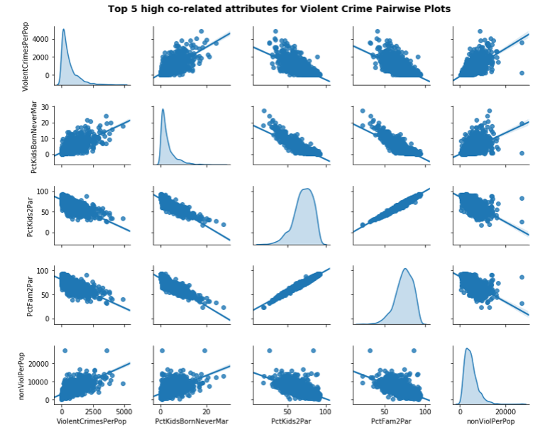
Factors correlated with the violent crimes
Communities have high positive co-relation among Non violent crime and violent crime rate.
Communities with high percentage of families with two parents with kids or teens have a strong negative impact on violent crime.
Communities with high percentage of Kids with never married parent have a high positive co-relation with violent crime.
Notes:
Confirm scope and phases
Integration with portal to be accessed by customers

Slide 9
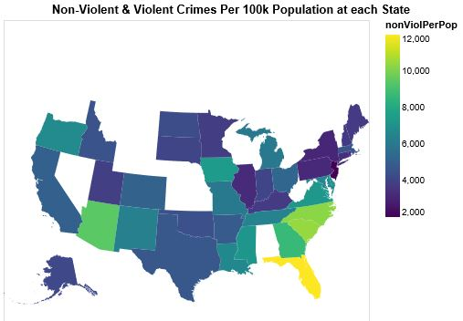
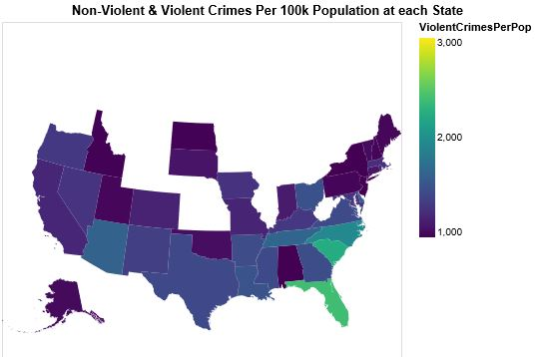
Non-Violent & Violent Crimes Per 100k Population at each State
Non violent Crimes By state
NJ being the smallest state has lowest aggregated non violent crimes
Florida has the highest non violent crimes
Violent Crimes By state
FL & DE has the highest violent crimes
Notes:
Confirm scope and phases
Integration with portal to be accessed by customers

Slide 10
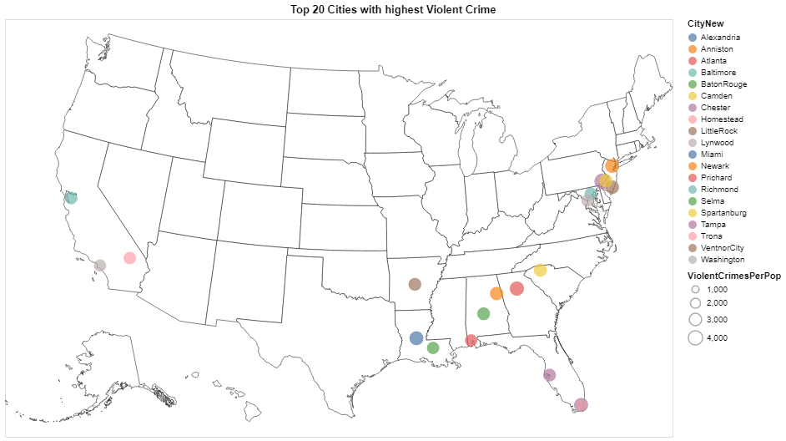
Top 20 cities with high volume of violent crimes
In terms of total no. of crimes (violent and non-violent), the top reported cities are Atlantic, East Longmeadow, Palatka, Dania and Miami.
California, Florida and Alabama states have 9 cities out 20 highly reported with total no. of crimes
California
Alabama
Florida
Notes:
Confirm scope and phases
Integration with portal to be accessed by customers

Slide 11
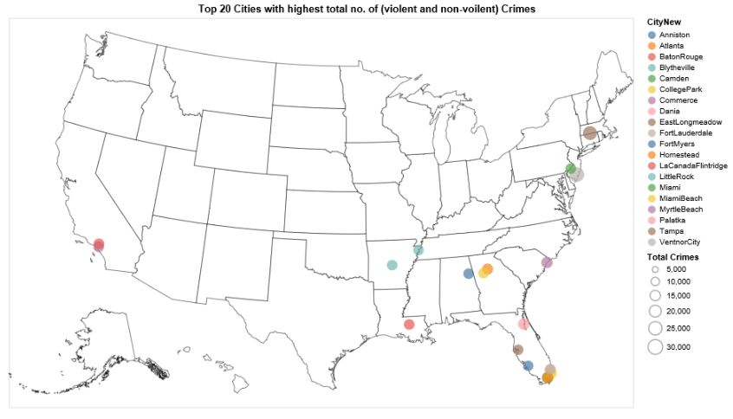
Results and Insights (Top 20 cities with high volume of crimes )
In terms of total no. of crimes (violent and non-violent), the top reported cities are Atlantic, East Longmeadow, Palatka, Dania and Miami.
Florida state has 8 out 20 highly reported cities with no. of crimes
Florida
Notes:
Confirm scope and phases
Integration with portal to be accessed by customers

Slide 12
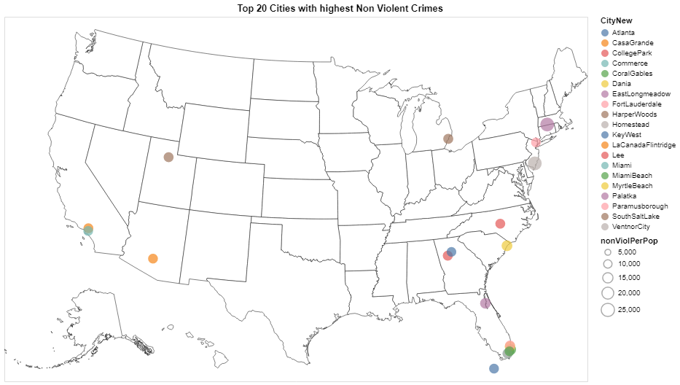
Results and Insights (Top 20 cities with high volume of Non-crimes )
For non-violent crimes, there are some cities like East Longmeadow, Atlantic, Myrtle Beach, Palatka and Miami Beach are reported with the highest no. of non-violent crimes.
Florida state has 8 out 20 highly reported cities with non-violent crimes
Florida
Notes:
Confirm scope and phases
Integration with portal to be accessed by customers

Slide 13
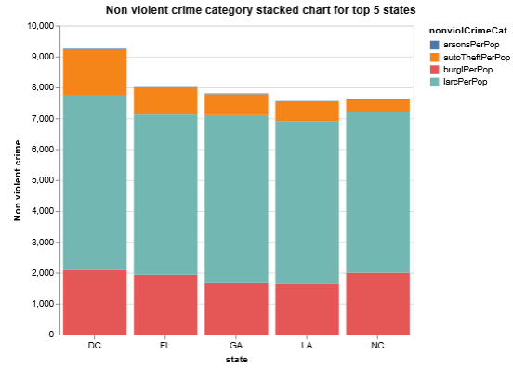
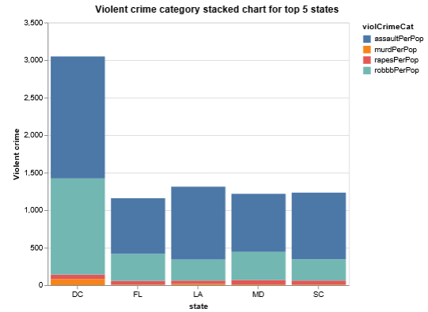
Average crime rate by category for top 5 states
For non-violent crimes, number of larcenies per 100K population is highest type of the non-violent crimes
For non-violent crimes, number of robberies and number of assaults per 100K are highest type of the non-violent crimes
Notes:
Confirm scope and phases
Integration with portal to be accessed by customers

Slide 14
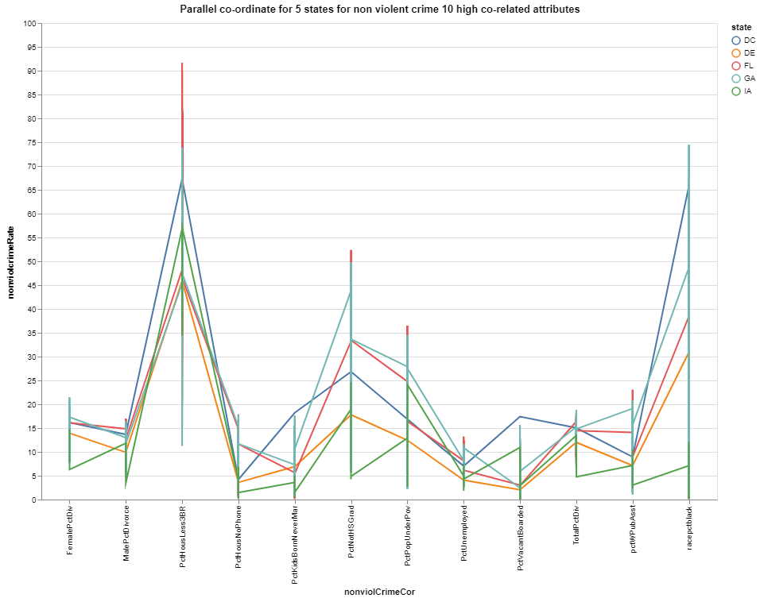
Factors correlated with the non-violent crimes for top 5 states
12 features out of 125 have high correlation with the non-violent crimes
Divorce, Unemployment, Literacy, Race are the major deciding factors for crimes
Factors are specific to states. Ex: Lack of high school education is the highest contributing factor in GA but it’s not the case for IA
Notes:
Confirm scope and phases
Integration with portal to be accessed by customers

Slide 15

Factors correlated with the violent crimes for top 5 states
Divorce has higher influence for non-violent crimes than the violent crimes
Notes:
Confirm scope and phases
Integration with portal to be accessed by customers

Slide 16
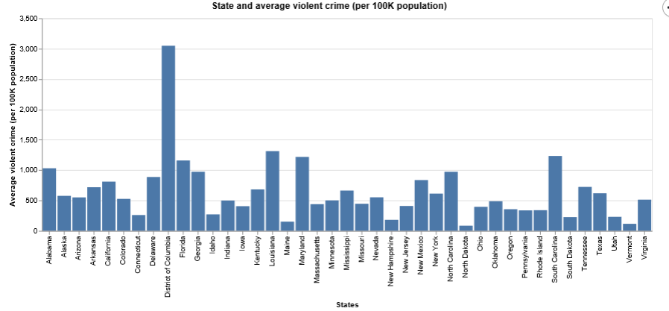
Average violent crime rate by state (per 100k population)
District of Columbia is the highest state followed by South Carolina and Louisiana
The lowest rate is for north Dakota, Maine and Vermont states.
Notes:
Confirm scope and phases
Integration with portal to be accessed by customers

Slide 17
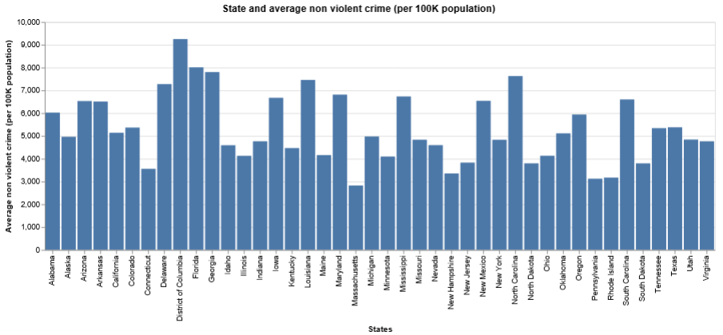
Average non-violent crime rate by state (per 100k population)
District of Columbia, Georgia, Florida and north of Carolina are the highest state reporting non-violent crimes
The lowest rate is for Massachusetts, Pennsylvania, Rhode, New Hampshire and Connecticut states.
Notes:
Confirm scope and phases
Integration with portal to be accessed by customers

Slide 18
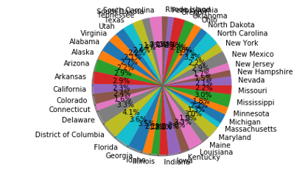
Visualization Techniques
We have used many charts and techniques to visualize the crime dataset. For example
For nominal/categorical fields such as state and community, we have used bar chart to represent each state and the quantity of crimes. We tried pie chart but the no. of states is 41 and it failed to give us clear insights
Pros of bar chart:
Good communication tool
Easy to interpret
Cons:
Using too many bars in a bar chart looks extremely cluttered
Readers can make comparisons of arbitrary data segments quickly on a bar chart, but are not able to compare two slices that are not neighbours at once
Notes:
Confirm scope and phases
Integration with portal to be accessed by customers

Slide 19
Visualization Techniques
For geo\GPS coordinates fields such as latitude and longitude, we have used Choropleth maps to show each state and the quantity of crimes.
Pros of Choropleth maps :
Helpful for finding intriguing hot spots, detecting relationships between the encoded variable and geographic location (and the many variables entangled with location), or letting people know how their area compares with others.
Cons:
Since the choropleth map uses an average number to represent defined areas, the viewer can not gain detailed information or perspective on any area’s internal conditions.
Notes:
Confirm scope and phases
Integration with portal to be accessed by customers

Slide 20
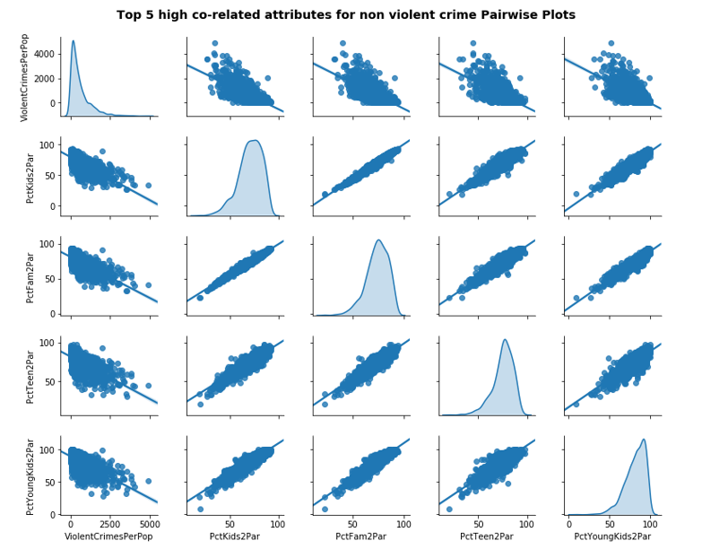
Visualization Techniques
For numeric/ decimal fields, we have used correlation matrix to show the relationship between variables of crimes.
Pros of Correlation Matrix:
Helpful for finding the relationship between variables.
Cons:
As the number of factors/variables increases over 6, it become harder to read and gain insights from the chart.
Notes:
Confirm scope and phases
Integration with portal to be accessed by customers

Slide 21
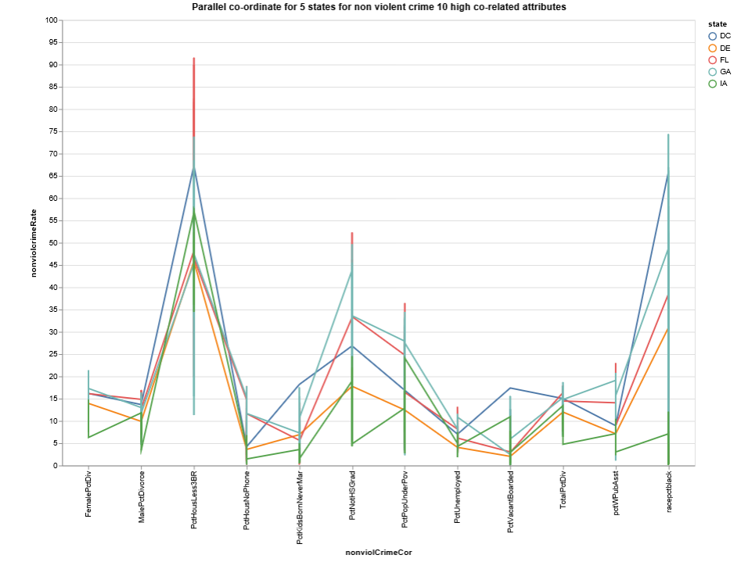
Visualization Techniques
For two numeric fields and one categorical field, we have used parallel co-ordinate chart to show the relationship between the state, the factors and the crime rate.
Pros of parallel co-ordinate :
It shows the interaction between the vraibles.
Cons:
As the number of factors/variables increases, it become harder to gain insights from the chart.
Notes:
Confirm scope and phases
Integration with portal to be accessed by customers

